Slide 1
Graph Implementation and Traversal

Slide 2
Graph Representation
Graphs represented in computer memory
  Two common ways
    Adjacency matrices
    Adjacency lists

Slide 3
Operations on Graphs
Commonly performed operations
  Create graph
    Store graph in computer memory using a particular graph representation
  Clear graph
    Makes graph empty
  Determine if graph is empty
  Traverse graph
  Print graph

Slide 4
Graphs Class
class graph
{
list<int> *Array;
int gSize;
void dft(int vertex, bool visited[]);
public:
graph(){Array=NULL;}
~graph(){clear();}
void createGraph();
void depthFirstTraversal();
void breadthFirstTraversal();
void clear();
bool isEmpty();
};

Slide 5
createGrapth()
This function creates a graph with Adj List
Graph data is provided to this function in a text file
A text file is to be created manually to represent a graph (next slide)

Slide 6
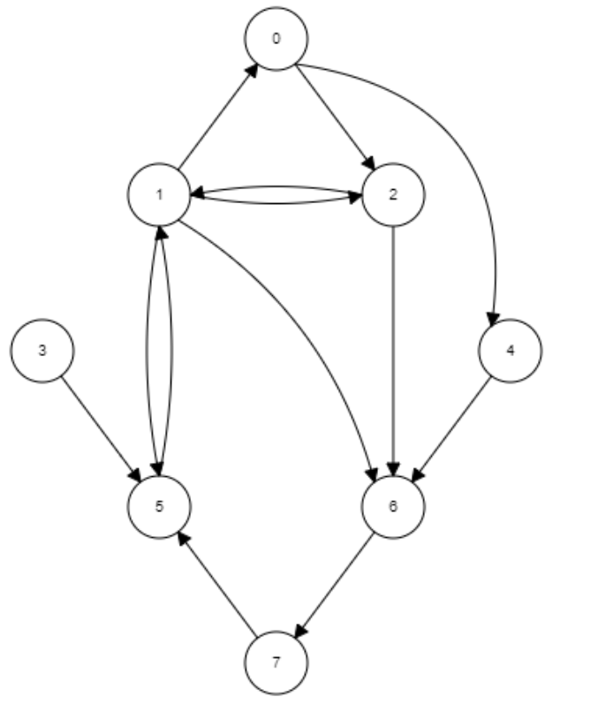
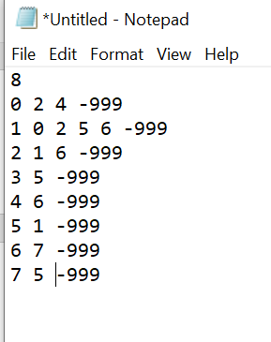
Representing a graph with a text file

Slide 7
File format explained
Number of vertices
Vertex number
Adjacent Vertices with -999 indicating end of line

Slide 8
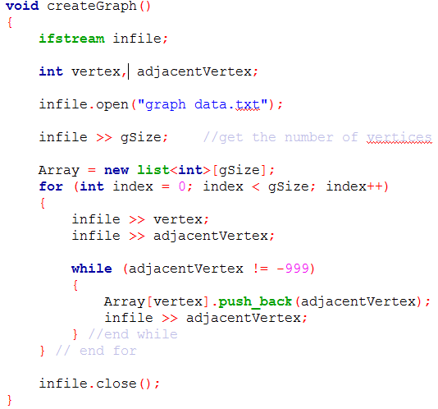

Slide 9
Graph Traversals
Processing a graph
  Requires ability to traverse the graph
Traversing a graph
  Visiting every node
Two most common graph traversal algorithms
  Depth first traversal
  Breadth first traversal

Slide 10
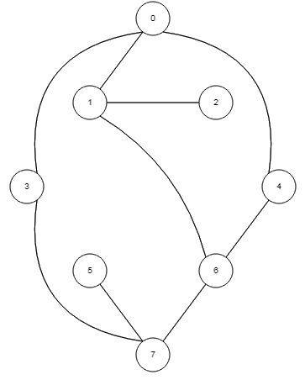

Depth First Traversal
Implementation:
How to mark a node
  Need a separate bool array

Slide 11
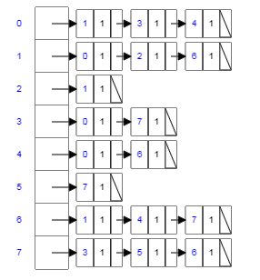

Slide 12
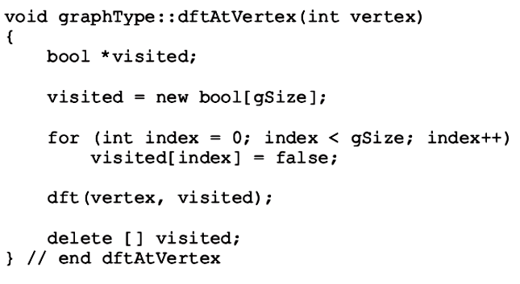
Depth First Traversal
Function depthFirstTraversal
  Performs a depth first traversal of entire graph
Function dftAtVertex
  Performs a depth first traversal at a given vertex

Slide 13
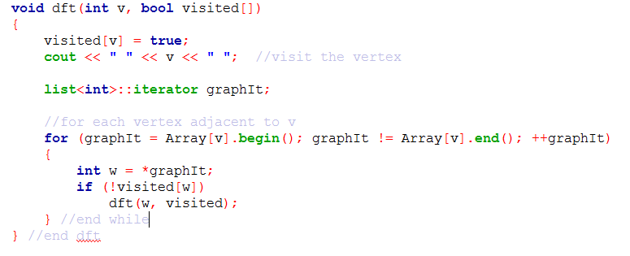
Depth First Traversal (cont’d.)
Recursive function dft implements algorithm

Slide 15

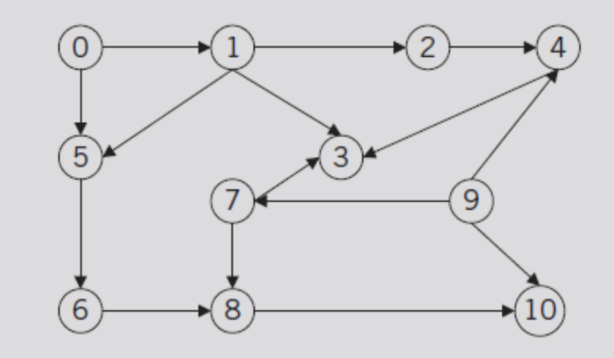
Depth First Traversal
To ensure all nodes are visited
FIGURE 12-7 Directed graph G₃

Slide 16
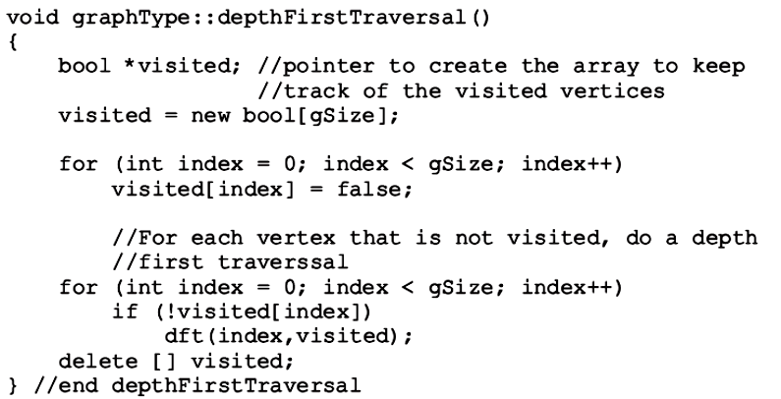
Depth First Traversal (cont’d.)
Function depthFirstTraversal
  Implements depth first traversal of the graph

Slide 17
Depth First Traversal (cont’d.)
Function dft implements algorithm

Slide 18
Breadth First Traversal

Slide 19
Breadth First Traversal
visit all adjacent nodes first, and then move to other nodes
Output: 0 1 3 4 2 6 7 5

Slide 20

Breadth First Traversal
visit all adjacent nodes first, and then move to other nodes
FIGURE 12-7 Directed graph G₃
Output:

Slide 21
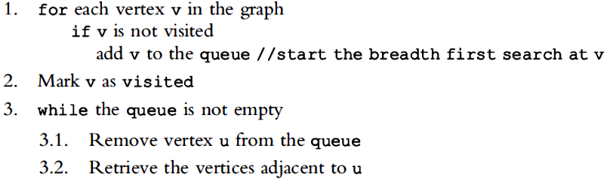
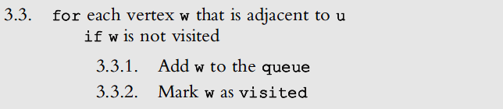

Slide 22
Breadth First Traversal (cont’d.)
General search algorithm
  Breadth first search algorithm with a queue
FIGURE 12-7 Directed graph G₃

Slide 23
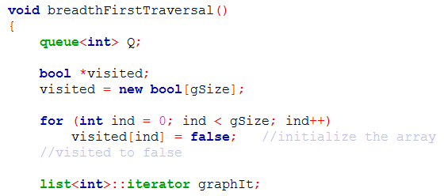
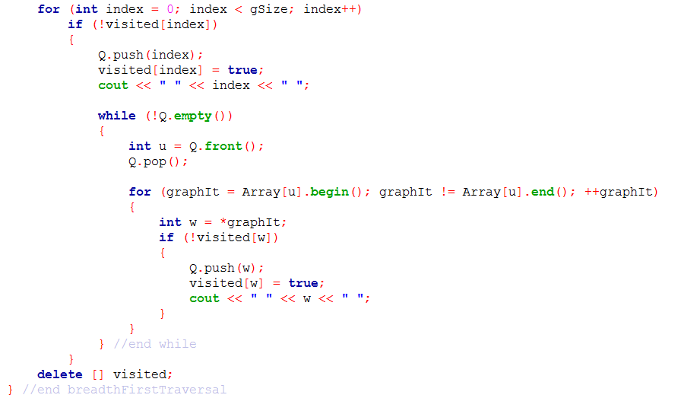

Slide 24
BFT
DFT and BFT have many applications in real life
One of the BFT application is finding shortest path on a non-weighted graph.

Slide 25

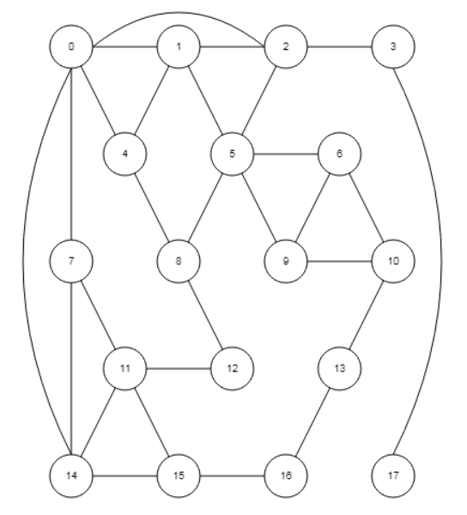
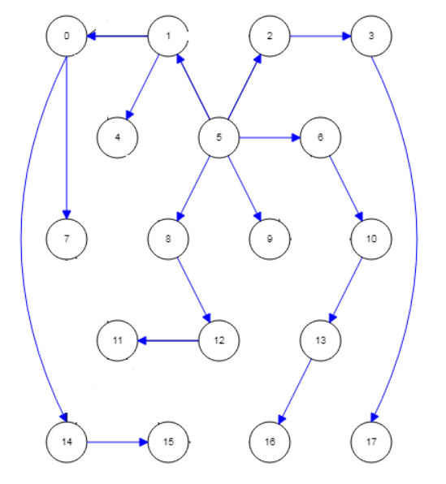
Shortest Path from vertex 5 to all other vertices
Data Structures Using C++ 2E

Slide 26
Shortest path tree
The shortest path found by the BFT is actually a tree rooted at starting point,
  As there is only one way to move from root to any other vertex
This tree serves as shortest path only for the root, i.e., vertex 5 in this example

Slide 27
How to make a Shortest Path Tree in a program
Data Structures Using C++ 2E

Slide 28
Parent[w] = u ;

